Slide 1
SPROCKET DESIGN
BY GALEN RILEY

Slide 2
GOALS
Create a single piece sprocket
Maintain critical dimensions so that sprocket fits with the current packaging
Save weight via design optimization and use of 7075-T6 Aluminum

Slide 3
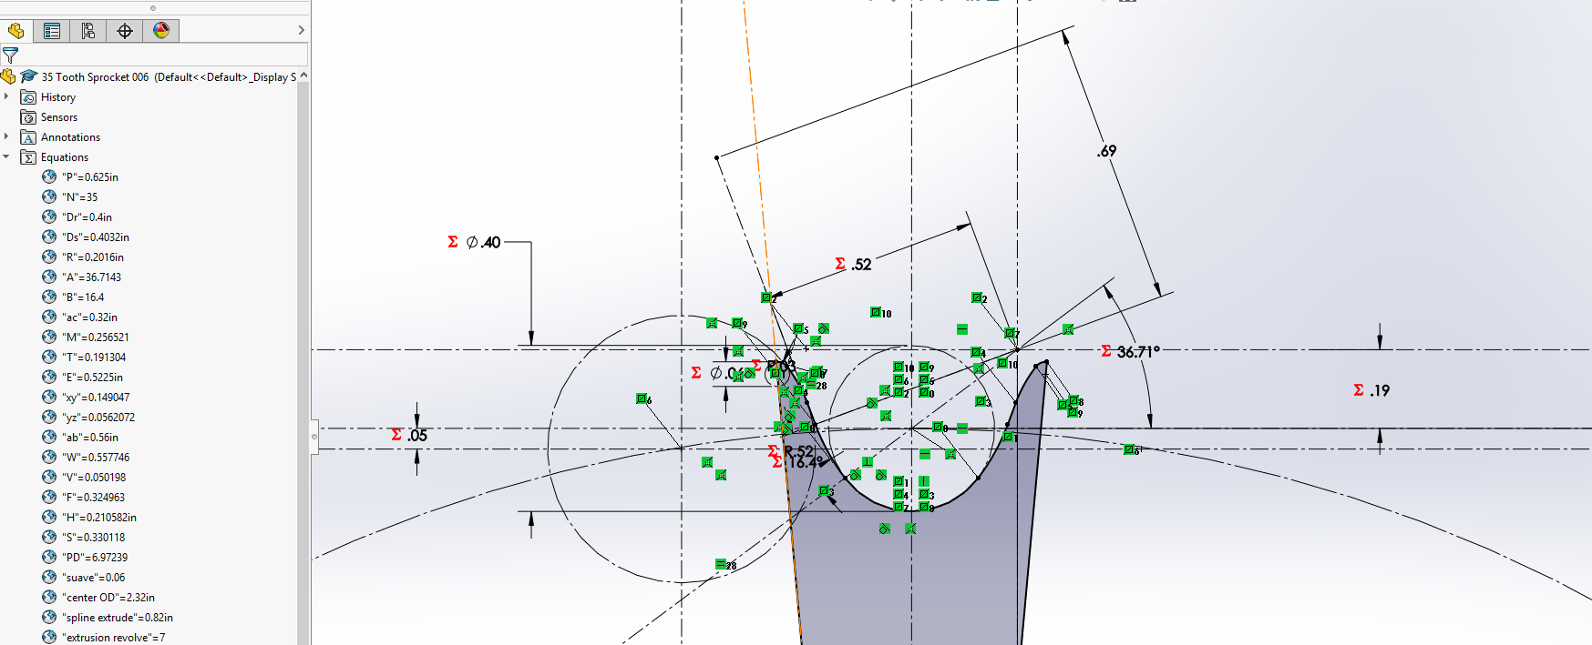
GEOMETRY
The formulas used to calculate the tooth geometry were taken from the American Chain Association Chains for Power Transmission and Material Handling handbook and should be compliant with industry standards…

Slide 4
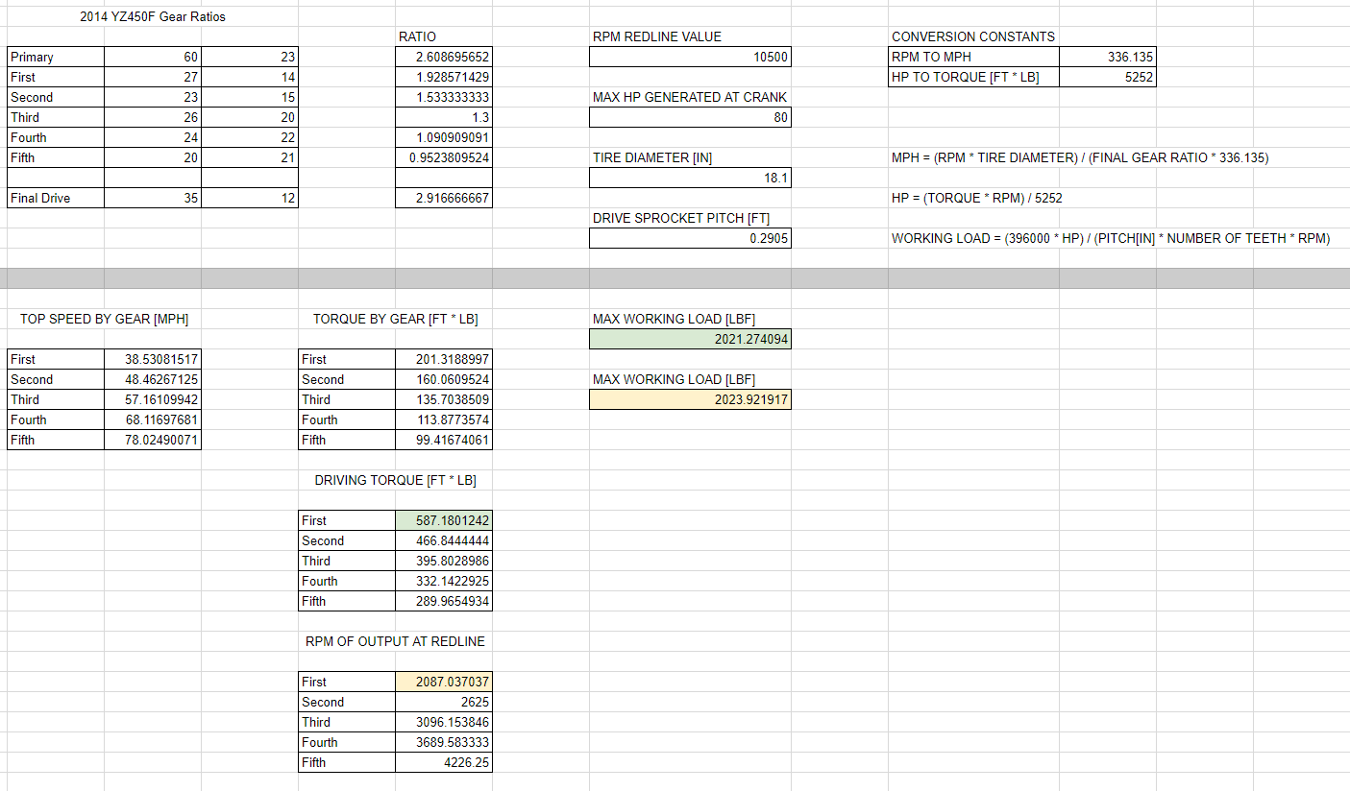
SPROCKET LOAD CALCULATIONS

Slide 5
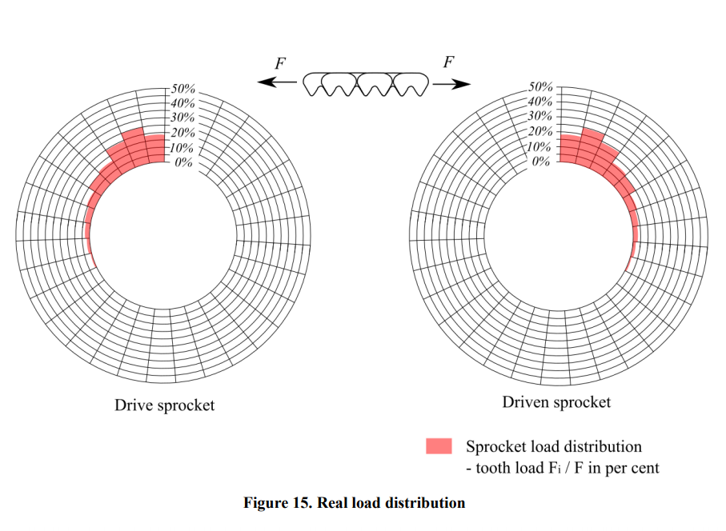
LOAD DISTRIBUTION RESEARCH
Research carried out by BorgWarner.

Slide 6
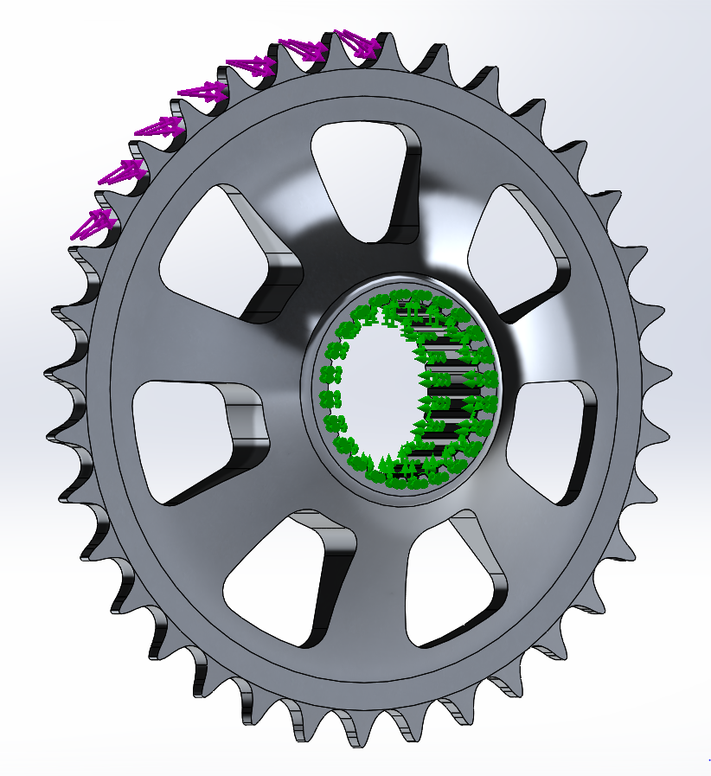
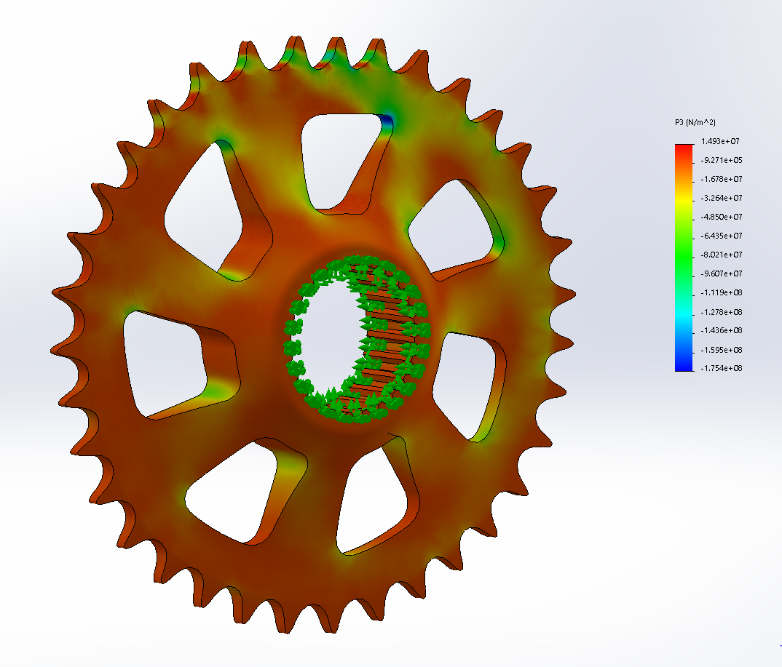
FEA ANALYSIS IN SOLIDWORKS
Force distribution applied
in accordance with
BorgWarner research
Maximum stress values
Observed in Third
Principal Direction
Overall FOS = 2.88

Slide 7
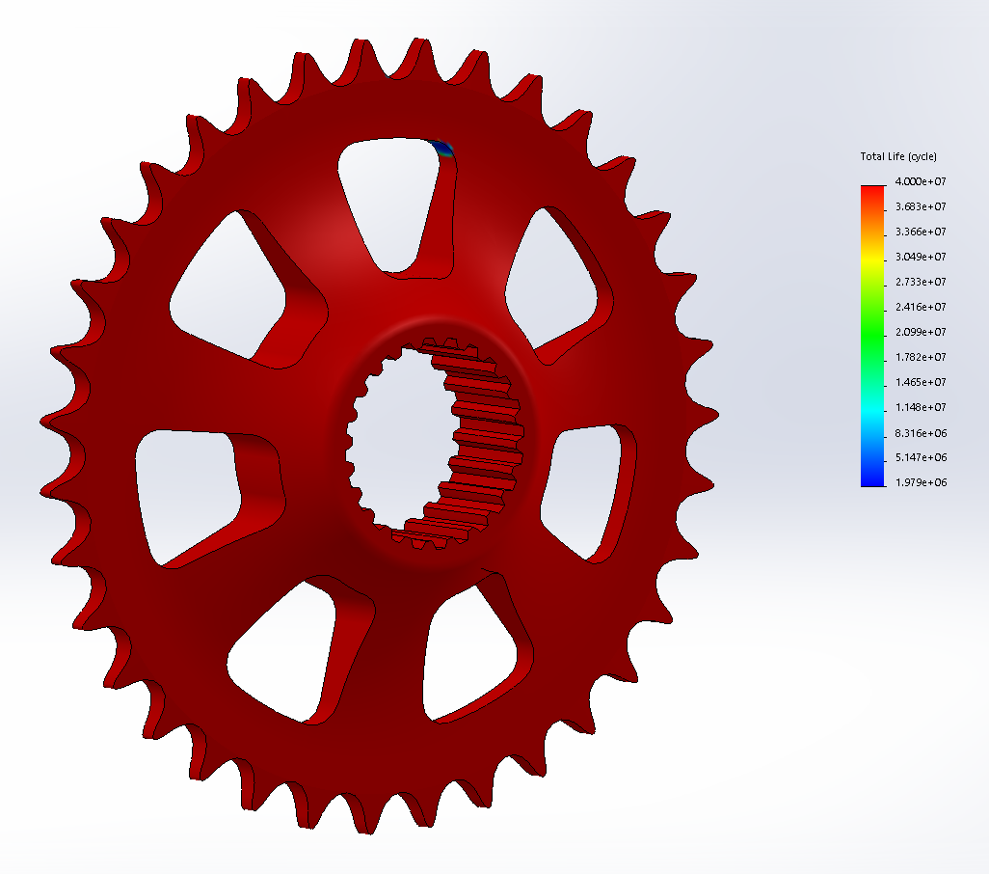
SOLIDWORKS FATIGUE LIFE SIMULATION
Revolutions per Endurance Event = 15,600
Solidworks estimated lifespan [cycles] = 1,979,000
Estimated lifespan of sprocket = 127 Endurance Events
Note: Loading events were zero based and scaled by
a factor of two for increased confidence in lifespan

Slide 8
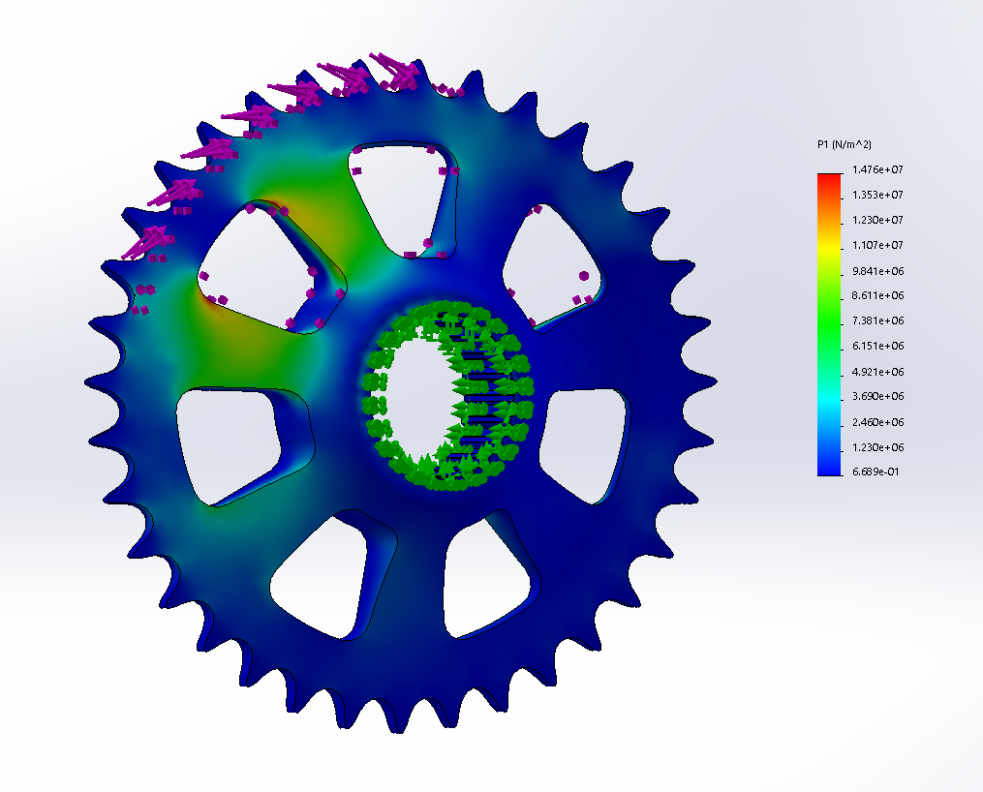
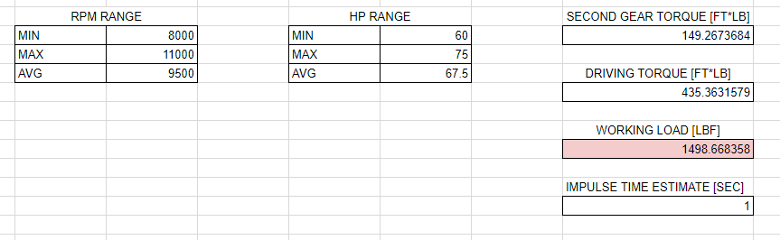
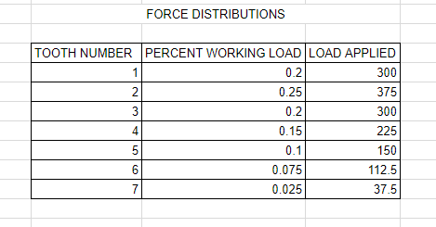
DYNAMIC LOADING SIMULATIONS
Simulation of a clutch drop during an average accel. event
Maximum first principal stress observed during dynamic loading event

Slide 9
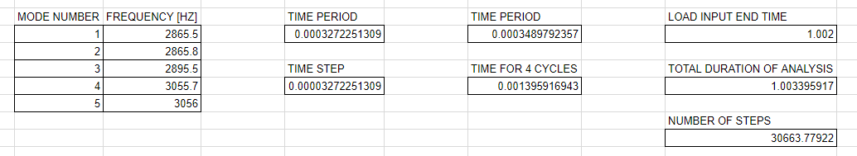
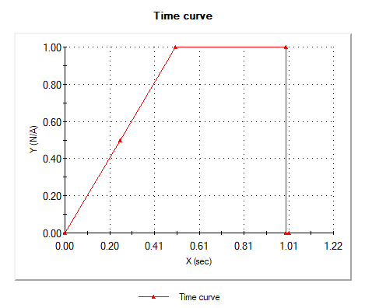
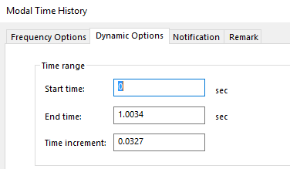
LIMITATIONS OF SOLIDWORKS
Unable to obtain full resolution of dynamic loading scenarios…
Lacking computing power and disk space to enhance resolution of results

Slide 10
CONCLUSION
Created a single piece sprocket
Sprocket will fit given packaging constraints
Estimated sprocket weight = 1.05 lbs
Two-piece sprocket weight (before hardware) = 1.99 lbs
Lacking resolutiom in dynamic loading situations

